Slide 1
GIS SITE SELECTION · SAN DIEGO COUNTY
797
Planet Fitness
Site Suitability Analysis
Candidate parcels evaluated
A demographic and competitive overlay analysis identifying the three most viable jurisdictions for a new franchise location
PREPARED BY
Mario Nonog
PROJECT DATE
May 2026
Notes:
[TITLE SLIDE — 30 seconds]
Hi, I'm Mario Nonog. Today I'm walking you through a GIS site suitability analysis I built for Planet Fitness — specifically, identifying the best place in San Diego County to open a new franchise location.
The big number on screen — 797 — is the count of candidate parcels that survived my screening process out of more than a million parcels in the county. Over the next 10 minutes, I'll show you how I got from 1 million to 797, and from 797 to a final shortlist of three jurisdictions.
[PAUSE — advance to next slide]

Slide 2
01 · THE QUESTION
PLANET FITNESS SITE SUITABILITY | 2 / 14
The Question
Where is the best place in San Diego County to open a new Planet Fitness franchise?
THE BUSINESS PROBLEM
THE GIS APPROACH
Planet Fitness's franchise model depends on a precise customer fit:
Value-conscious customers with household incomes between $50K and $75K
A working-age population (18–44) dense enough to fill memberships
Sufficient distance from existing gyms to avoid cannibalization
Layer every relevant variable, score every parcel, then rank.
This analysis converts an open-ended business question into a measurable, defensible GIS workflow built on three pillars:
INCOME FIT · DEMOGRAPHIC FIT · COMPETITIVE DISTANCE
The output is a tiered jurisdiction ranking backed by parcel-level evidence — usable directly by a franchise selection team.
Prepared by Mario Nonog | GIS Project | May 2026
Notes:
[THE QUESTION — 45 seconds]
So the core question is: where should Planet Fitness open next in San Diego County?
This isn't a vague question — Planet Fitness has a very specific customer profile. They're a low-cost gym, $10 to $25 a month, targeting value-conscious customers with household incomes in a specific band. They need three things in any new location:
First, the right income demographic — not too poor to afford even a discount membership, not too wealthy to bother with one.
Second, enough working-age population nearby to fill the gym.
And third, enough distance from existing competitors that they're not just stealing each other's customers.
My GIS approach turns that vague business question into something measurable — I layer every relevant variable, score every parcel in the county, then rank the results.
[Advance to next slide]

Slide 3
02 · DATA SOURCES
PLANET FITNESS SITE SUITABILITY | 3 / 14
The Data
Three authoritative datasets, integrated by geographic location
SOURCE 01
SOURCE 02
SOURCE 03
SanGIS Parcels
ACS Demographics
Competitor Locations
2024
2018–2022
2026
Every taxable parcel in San Diego County, with assessor-coded land use, zoning, acreage, and address. Updated weekly.
U.S. Census Bureau American Community Survey 5-Year Estimates at the Census tract level: median household income and population by age.
Existing Planet Fitness and 24 Hour Fitness storefronts, manually compiled from corporate websites and geocoded.
1.05 M
736
30+
Total parcels countywide
Census tracts in San Diego County
Competitor sites mapped
Prepared by Mario Nonog | GIS Project | May 2026
Notes:
[DATA SOURCES — 1 minute]
The analysis combines three datasets.
First, SanGIS parcels — this is the official San Diego County parcel database, updated weekly. Every taxable property in the county is in here, with its land use code, zoning, acreage, and address. Over a million parcels total.
Second, Census demographics — specifically the American Community Survey 5-Year Estimates from 2018 to 2022, at the Census tract level. I pulled two things: median household income, and a calculation I built myself for the percentage of population aged 18 to 44.
Third, competitor locations — existing Planet Fitness and 24 Hour Fitness storefronts. I manually compiled these from the corporate websites and geocoded them.
The key here is that all three datasets are tied together by geographic location. A parcel inherits the demographics of the tract it falls inside, and gets screened against the competitor buffer.
[Advance to next slide]

Slide 4
03 · METHODOLOGY
PLANET FITNESS SITE SUITABILITY | 4 / 14
The Process
Five sequential filters reduce 1 million parcels to a defensible shortlist
01
02
03
04
05
GATHER
EXCLUDE
FILTER
ENRICH
SCORE
Load parcels,
demographics,
competitor sites
2-mile buffer
around existing
gyms removed
Keep commercial
zoning + acreage
≥ 1.5 acres
Spatial join with
income + age
tract data
Weighted index:
income 55%,
demographics 45%
OUTCOME
From a million parcels to a shortlist of just 28
1,054,840 → 797 → 28 top recommended sites
Prepared by Mario Nonog | GIS Project | May 2026
Notes:
[METHODOLOGY OVERVIEW — 45 seconds]
The analysis is a five-step funnel.
Step one: gather all the data.
Step two: exclude — I drew a 2-mile buffer around every existing gym and erased any parcel that fell inside those buffers. This removes already-saturated trade areas.
Step three: filter for buildable commercial land — I only kept parcels with the right land use codes and at least one and a half acres.
Step four: enrich — I spatially joined the income and demographic data from the Census tracts onto every surviving parcel.
Step five: score — I built a weighted index combining income fit and demographic fit.
The bottom of the slide shows the result: from over a million parcels, down to 797 candidates, down to the 28 top-recommended sites I ended up flagging.
[Advance to next slide]

Slide 5
04 · SPATIAL FILTERING
PLANET FITNESS SITE SUITABILITY | 5 / 14
Filtering the Universe
Two spatial filters eliminated saturated zones and non-buildable land
FILTER 01 · COMPETITOR BUFFER
THE FUNNEL
Exclude parcels within 2 miles of any existing Planet Fitness or 24 Hour Fitness location
1,054,840
Starting universe
ArcGIS Buffer tool created 2-mile rings around each competitor. Erase tool removed any parcel intersecting these rings — eliminating already-saturated trade areas.
After 2-mile buffer
778,615
FILTER 02 · LAND USE + SIZE
Keep only buildable commercial parcels of adequate size
After commercial filter
797
SQL filter on SanGIS attributes:
NUCLEUS_US IN (200, 213, 215, 216, 230, 240, 250, 251, 252, 340)
AND ACREAGE >= 1.5 AND NUCLEUS_ZO IN (50, 60)
= vacant commercial, strip retail, shopping centers, standalone retail
Each step is defensible: the buffer reflects franchise trade-area conventions; the land-use filter mirrors actual Planet Fitness real estate criteria.
Prepared by Mario Nonog | GIS Project | May 2026
Notes:
[SPATIAL FILTERING — 1 minute]
Let me zoom in on the spatial filters.
Filter one removes parcels too close to existing gyms. I used the ArcGIS Buffer tool to draw a 2-mile ring around each Planet Fitness and 24 Hour Fitness in the county, then used the Erase tool to cut out any parcels intersecting those rings. The 2-mile threshold reflects standard franchise trade-area conventions — it's the typical drawing distance for a gym.
Filter two keeps only parcels that could actually support a gym. I used a SQL query against the SanGIS land use codes to keep things like vacant commercial, strip retail, and shopping centers — and I required a minimum of 1.5 acres because Planet Fitness needs that much for the building plus parking.
The funnel on the right shows the impact: I started with about 1.05 million parcels, dropped to 778,000 after the competitor buffer, and dropped again to 797 after the commercial filter. Each filter is defensible — the buffer matches industry conventions, the land-use rules mirror Planet Fitness's actual real estate criteria.
[Advance to next slide]

Slide 6
05 · SCORING FRAMEWORK
PLANET FITNESS SITE SUITABILITY | 6 / 14
Scoring Each Parcel
Two demographic dimensions converted from raw data to comparable 1–10 scores
INCOME SCORE · WEIGHT 55%
POPULATION SCORE · WEIGHT 45%
Median household income fit
Working-age population concentration
Planet Fitness targets value-conscious customers, not luxury gym-goers. The scoring bracket peaks at $50K–$75K — the brand's documented core demographic.
Calculated for each tract: percentage of population aged 18–44, summed from 16 ACS sex-and-age fields using a custom Arcade expression.
INCOME RANGE | SCORE | FIT
$50K – $75K | 10 | Bullseye
$40–50K or $75–85K | 8 | Strong fit
$30–40K or $85–100K | 5 | Marginal
< $30K or > $100K | 2 | Poor fit
% AGED 18–44 | SCORE | FIT
> 50% | 10 | Densely young
40 – 50% | 8 | Strong
30 – 40% | 5 | Average
< 30% | 1–3 | Weak / older skew
Prepared by Mario Nonog | GIS Project | May 2026
Notes:
[SCORING FRAMEWORK — 1 minute]
Once I had my 797 candidates, every parcel got two scores, each on a 1 to 10 scale.
On the left is the income score. Planet Fitness targets households making $50,000 to $75,000 — that's slightly below the U.S. median and squarely in their pricing sweet spot. I gave parcels in that range a score of 10. Parcels in nearby income bands got 8, then 5 if they were further off, and 2 if the surrounding tract was either very low-income or very high-income — both being poor fits for the brand.
On the right is the population score. For every Census tract I summed the population aged 18 to 44 using sixteen separate Census variables — male and female across eight age brackets each — and divided by total population. Tracts where over half the population was 18 to 44 got a 10. The percentage drops, the score drops.
Both scores are converted from raw numbers to comparable 1 to 10 values, so they can be combined.
[Advance to next slide]

Slide 7
06 · COMBINED SUITABILITY
PLANET FITNESS SITE SUITABILITY | 7 / 14
The Final Score
Income and demographic scores combined into a single weighted index
THE FORMULA
Final Score = (Income Score × 0.55) + (Population Score × 0.45)
WHY 55 / 45?
Income is the slightly stronger predictor of Planet Fitness performance — the brand's pricing model depends on a specific household-income band. Population density of the 18–44 demographic is a close second: without enough target-age residents in walking or short-driving distance, even a perfect income match will struggle to fill memberships.
(10 × 0.55) + (10 × 0.45) = 10.0 Bullseye site
(10 × 0.55) + (8 × 0.45) = 9.1 Strong fit
(5 × 0.55) + (8 × 0.45) = 5.6 Marginal
Prepared by Mario Nonog | GIS Project | May 2026
Notes:
[THE FORMULA — 30 seconds]
Combining the two: Final Score equals Income Score times 0.55 plus Population Score times 0.45.
Why this split? Because Planet Fitness's business model is fundamentally an income-defined model — their pricing is built around a specific household-income band. Income leads. But demographics support — a perfect income match with no working-age residents nearby still won't fill memberships. So income gets the slightly higher weight, demographics gets the close second.
These weights are a modeling choice based on the brand's strategy — not a regression result. With actual store performance data, you could calibrate them more precisely.
The bottom of the slide shows three example outputs: a bullseye site at 10.0, a strong fit at 9.1, and a marginal site at 5.6.
[Advance to next slide]

Slide 8
07 · RESULTS
PLANET FITNESS SITE SUITABILITY | 8 / 14
The Rankings
Mean Final Score across all candidate parcels, by jurisdiction
MEAN FINAL SCORE · TOP 10 JURISDICTIONS
01
La Mesa
La Mesa
7.98
n = 8
Mean 7.98 · 8 parcels
Oceanside
6.16
n = 93
Highest demographic match, limited inventory
Escondido
5.94
n = 55
Imperial Beach
5.55
n = 2
02
Oceanside
San Marcos
5.36
n = 60
Mean 6.16 · 93 parcels
National City
5.29
n = 17
Best balance of fit and site availability
Vista
5.16
n = 45
San Diego
5.08
n = 113
03
Escondido
Chula Vista
4.98
n = 52
Mean 5.94 · 55 parcels
El Cajon
4.71
n = 5
Strong North County inland opportunity
Prepared by Mario Nonog | GIS Project | May 2026
Notes:
[RANKINGS — 1 minute]
Here are the results, ranked by mean Final Score across all candidate parcels in each jurisdiction.
La Mesa wins, with a mean score of 7.98 across its 8 qualifying parcels. Oceanside is second at 6.16 — but with 93 qualifying parcels, so dramatically more inventory. Escondido is third at 5.94 with 55 parcels.
The bottom seven cities on this chart — from Imperial Beach down through El Cajon — are clustered in the 4.7 to 5.6 range. They're not bad, but they're not as well-aligned as the top three.
One important thing to call out — the cities you don't see on this slide are the coastal wealthy areas like Del Mar, Solana Beach, and Encinitas. They actually ranked at the very bottom of the analysis. Beautiful neighborhoods, high population, but incomes far above Planet Fitness's target band — so they scored poorly on demographic fit.
The right side of the slide shows our three winners with a quick note on what makes each one notable.
[Advance to next slide]

Slide 9
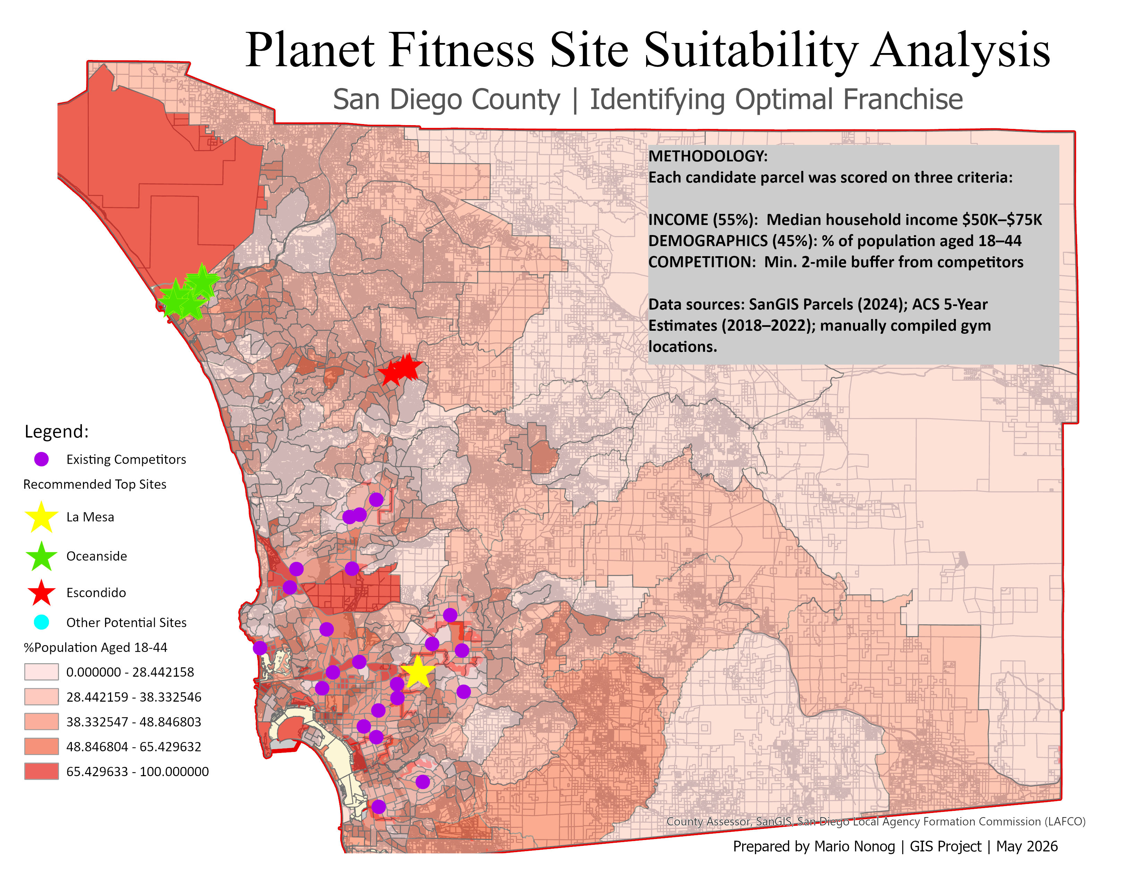
08 · COUNTYWIDE VIEW
PLANET FITNESS SITE SUITABILITY | 9 / 14
The Map — Countywide View
All 28 top-scoring parcels (stars) plotted across San Diego County with demographic background
Bright red area in the north is Camp Pendleton — high working-age population but no commercial land, correctly excluded as candidate.
Prepared by Mario Nonog | GIS Project | May 2026
Notes:
[COUNTYWIDE MAP — 1 minute]
This is the full map. Every star is one of the 28 top-recommended parcels, color-coded by jurisdiction — gold for La Mesa, green for Oceanside, red for Escondido.
The background shading shows the percentage of population aged 18 to 44 per Census tract — darker red means more working-age residents.
Two things to point out. First, look at the cluster of green stars in the northwest — that's Oceanside, with the most candidate sites of any city. Second, see that bright red block at the top of the map? That's Camp Pendleton, the military base. It's red because military bases have very high working-age populations — but it correctly got excluded from candidates because it has no commercial land.
The purple dots scattered through the map are existing competitor gyms. Notice the gaps — where there are no purple dots and you see colored stars, those are the highest-opportunity areas.
[Advance to next slide]

Slide 10
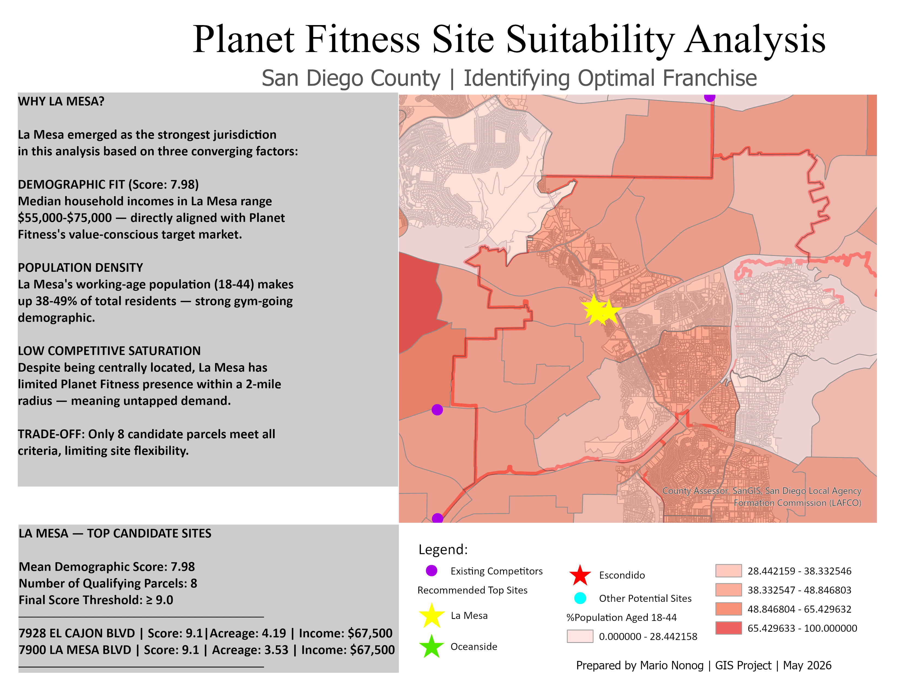
09 · RANK #1
PLANET FITNESS SITE SUITABILITY | 10 / 14
01
La Mesa
Mean Score 7.98 · 8 parcels · Highest demographic match
Prepared by Mario Nonog | GIS Project | May 2026
Notes:
[LA MESA — RANK #1 — 1 minute]
La Mesa took the top spot.
Three things drove its number-one ranking. First, demographic fit — La Mesa's median household incomes land right in the $55,000 to $75,000 range, almost perfectly aligned with Planet Fitness's target market. Second, population density — 38 to 49 percent of La Mesa residents are between 18 and 44, a strong gym-going demographic. Third, low competitive saturation — there's a real gap in Planet Fitness coverage here.
The trade-off: only 8 parcels meet all the criteria. So the demographic fit is exceptional, but there's limited site flexibility.
The two top addresses I'd recommend ground-truthing first are 7928 El Cajon Boulevard and 7900 La Mesa Boulevard — both with scores of 9.1 and both with solid commercial acreage.
[Advance to next slide]

Slide 11
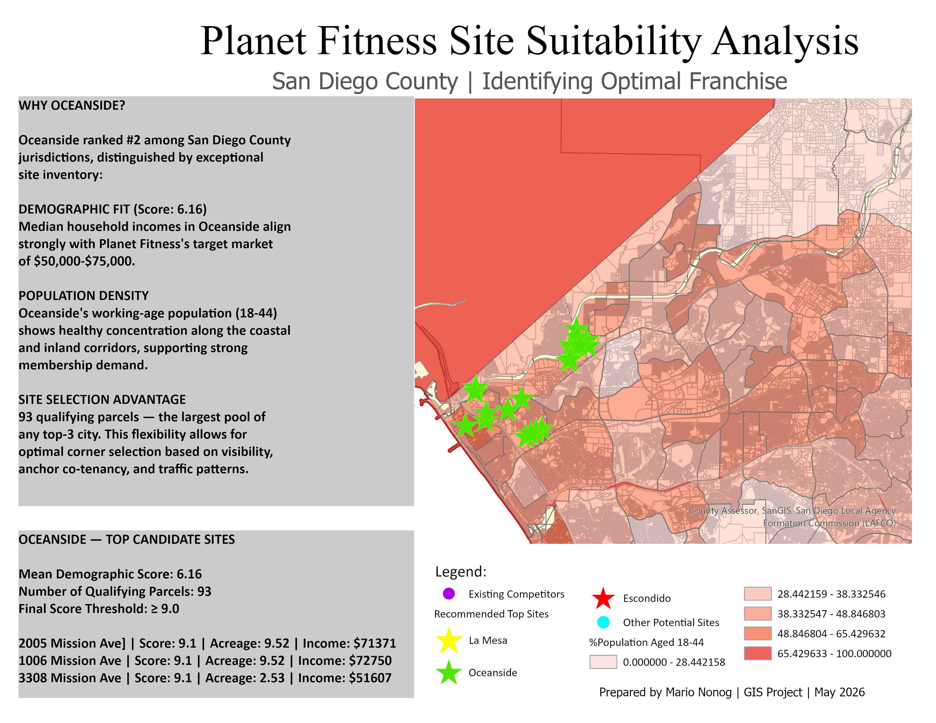
10 · RANK #2
PLANET FITNESS SITE SUITABILITY | 11 / 14
02
Oceanside
Mean Score 6.16 · 93 parcels · Best balance of fit & inventory
Prepared by Mario Nonog | GIS Project | May 2026
Notes:
[OCEANSIDE — RANK #2 — 1 minute]
Oceanside came in second by mean score — but it's the one I'd actually recommend opening first.
Here's why: Oceanside has 93 qualifying parcels. That's the largest pool of any top-3 city — over ten times more options than La Mesa. In real franchise selection, inventory matters enormously. You need flexibility to negotiate leases, pick the right corner, check parking and visibility, and find anchor co-tenancy with the right retail neighbors.
Demographically, Oceanside's incomes align well with the target market — especially inland from the coast — and the working-age population shows healthy concentration along both the coastal and inland corridors.
So while La Mesa scored a bit higher on pure fit, Oceanside offers what franchise teams actually care about — choice.
[Advance to next slide]

Slide 12
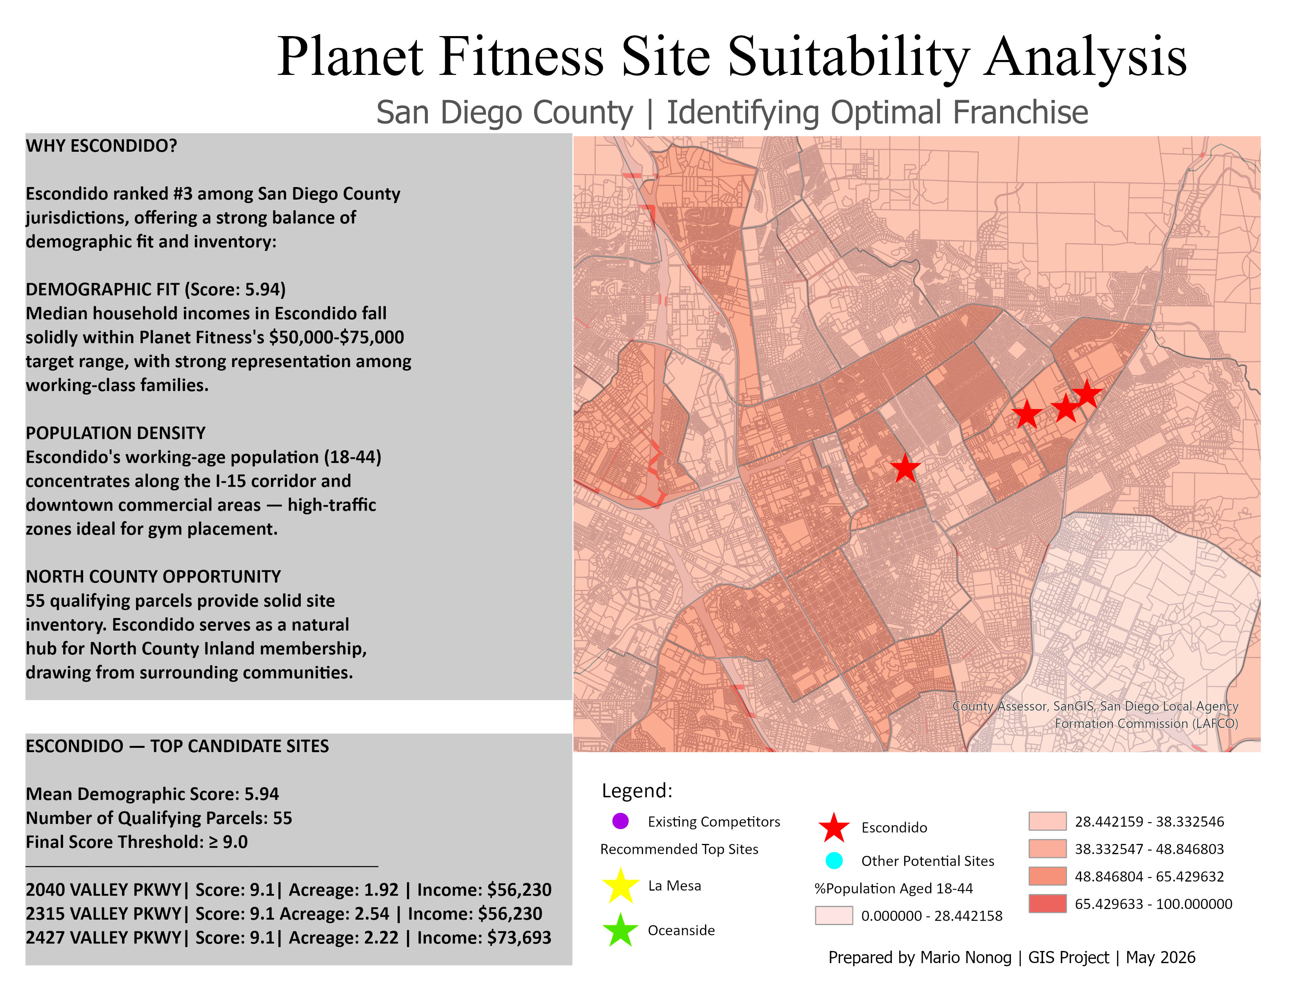
11 · RANK #3
PLANET FITNESS SITE SUITABILITY | 12 / 14
03
Escondido
Mean Score 5.94 · 55 parcels · Strong North County opportunity
Prepared by Mario Nonog | GIS Project | May 2026
Notes:
[ESCONDIDO — RANK #3 — 1 minute]
Third is Escondido, in North County Inland.
Mean score of 5.94 with 55 qualifying parcels. Incomes fall solidly within the target range, with strong representation among working-class families. The working-age population concentrates along the Interstate 15 corridor and downtown — high-traffic zones, ideal for gym placement.
What I want to highlight here is a specific corridor — Valley Parkway. Four of Escondido's top-scoring parcels are clustered along Valley Parkway. That's a really strong signal that this commercial strip has the right demographic and competitive profile. If I were the franchise team, that's the first place I'd send a real estate scout.
The three highlighted addresses — 2040, 2315, and 2427 Valley Parkway — are all score 9.1 with 1.9 to 2.5 acres each.
[Advance to next slide]

Slide 13
12 · INSIGHTS & LIMITATIONS
PLANET FITNESS SITE SUITABILITY | 13 / 14
Key Insights & Limitations
What this analysis reveals — and what it cannot say
KEY INSIGHTS
LIMITATIONS
Demographics matter more than density
Coastal areas (Del Mar, Solana Beach, Encinitas) ranked lowest despite high population — incomes far above PF's target band.
The single best site is in National City
0 Bay Marina Dr scored a perfect 10.0 — but with only 17 candidate parcels citywide, National City didn't crack the top 3 by mean score.
Valley Parkway is a hot corridor
Four of the top 28 sites cluster along Valley Pkwy in Escondido — suggesting strong demographic alignment in that commercial strip.
Inventory matters as much as mean score
La Mesa scored highest but offers only 8 sites. Oceanside's 93 sites give a franchise team room to negotiate.
Two dimensions, not all dimensions
Foot traffic, parking, visibility from major roads, anchor co-tenancy, and lease availability are not captured — all matter to real franchise decisions.
Tract-level demographics smooth out neighborhoods
A single Census tract may contain very different micro-neighborhoods. Block-group data would be sharper for site-level decisions.
Land-use codes lag reality
SanGIS warns its land-use field is updated irregularly. A parcel listed as "vacant commercial" may have a new tenant; ground-truthing is essential.
Buffer assumption
The 2-mile competitor radius is appropriate for urban San Diego but conservative for North County. A variable buffer would refine results.
Prepared by Mario Nonog | GIS Project | May 2026
Notes:
[KEY INSIGHTS & LIMITATIONS — 1 minute]
A few key insights worth flagging.
On the left — the analysis turned up some non-obvious findings. Demographics matter more than density: the coastal wealthy areas scored lowest despite high populations. The single best site countywide is in National City — but with only 17 candidate parcels there, the city didn't make the top 3 by mean. Valley Parkway in Escondido is a strong corridor with multiple high-scoring sites clustering there. And inventory matters as much as mean score — which is why I'm recommending Oceanside operationally even though La Mesa scored higher.
On the right — the honest limitations. This analysis is two-dimensional: income and demographics. Foot traffic, parking, visibility, anchor co-tenancy — none of that is captured. Tract-level demographics smooth out neighborhoods that might actually be very different from each other. SanGIS land-use codes can lag reality. And my 2-mile competitor buffer is appropriate for urban San Diego but probably too conservative for North County.
I want to be transparent that the scoring weights — 55 percent income, 45 percent population — are a reasoned choice, not a statistically calibrated coefficient. With actual store performance data, those weights could be refined.
[Advance to next slide]

Slide 14
13 · NEXT STEPS
Recommendations
Where this analysis points next
01
Ground-truth the top 10
02
Add a third scoring dimension
Visit highest-scoring parcels in person. Check visibility, parking, anchor co-tenancy, and adjacent retail mix that GIS can't capture.
Drive-time analysis using ArcGIS Network Analyst. A site with strong demographics but poor accessibility won't perform.
03
Refine with block-group data
04
Variable competitor buffers
Re-run the demographic overlay at the Census block-group level for sharper neighborhood-scale precision in dense areas.
Apply tighter buffers (1.5 mi) in dense urban zones and wider buffers (4–5 mi) in North County to reflect real trade-area geometry.
Thank you
Prepared by Mario Nonog · GIS Project · May 2026
Notes:
[RECOMMENDATIONS & THANK YOU — 45 seconds]
Where does this analysis point next?
Four concrete next steps.
One: ground-truth the top 10 highest-scoring parcels — meaning, send someone there in person to check visibility, parking, and adjacent retail mix. GIS can't see those things.
Two: add a third scoring dimension — drive-time analysis using ArcGIS Network Analyst. A site with perfect demographics but bad accessibility won't perform.
Three: refine demographics to the Census block-group level for sharper neighborhood-scale precision.
Four: apply variable competitor buffers — tighter in dense urban zones, wider in North County — to reflect real trade-area geometry.
To summarize the whole analysis in one sentence: La Mesa scored the highest, but Oceanside is probably the smarter business pick because of inventory flexibility, and Escondido is a strong North County hedge.
Thank you. Happy to take any questions.
[END]

